Slide 1
PREDICTING MOVIE RATINGS
Nicholas amoscato, Julie de Lorenzo and chun ping ng

Slide 2
OVERVIEW

Slide 3

Why predict movie ratings?
Theoretically you could predict the success of an arbitrary movie prior to its production
You can prevent big failures at the box office and give the films with the most potential the best financing

Slide 4
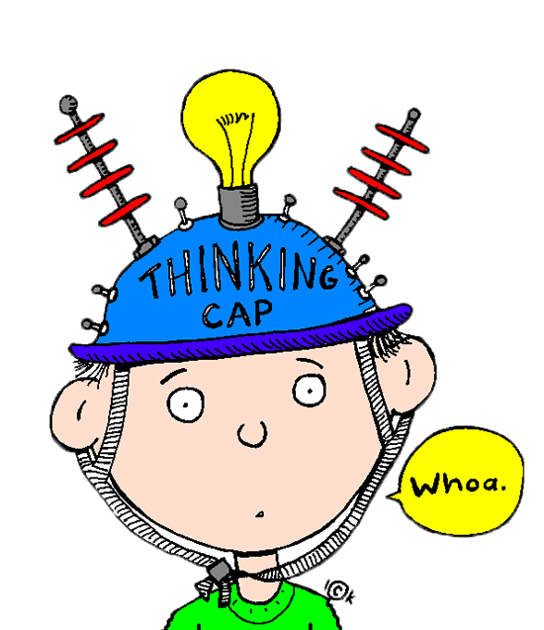
Okay, money. Why else?
It also allows for a better understanding of what draws us in to a film or turns us away
We can identify the unifying features of the stories we connect to most

Slide 5
Related work: Augustine, Pathak, u. texas
Achal Augustine and Manas Pathak from U. Texas explored the relationship between a film’s quality and a subset of the individuals involved
Looking at 1100 movies from 1995-2006 they had a test error of 9.983 %

Slide 6
Related work : Armstrong, yoon CMU
Nick Armstrong and Kevin Yoon from CMU looked at the relationship between a movie’s average rating on IMDB and some of the film’s attributes
They used Sequential Forward Search to narrow the features and then applied the kernel regression and linear model tree models
They achieved 14.11 % (kernel regression) and 14.40 % (model tree) deviation from the true rating (the baseline was 16.07%)

Slide 7
Related work: Steven haar, s. Illinois u.
Haar also used IMDB data but limited it to feature-length films from the US, a subset of 44,000 films
He applied to this subset multivariate linear regression as well as artificial neural network
Neural network had 0.640 mean error, Linear regression 0.828 as compared with control of 1.034
Concluded that neural network was superior for this type of calculation because it wasn’t limited to a linear model

Slide 8
approach
Preprocessing & Feature selection

Slide 9
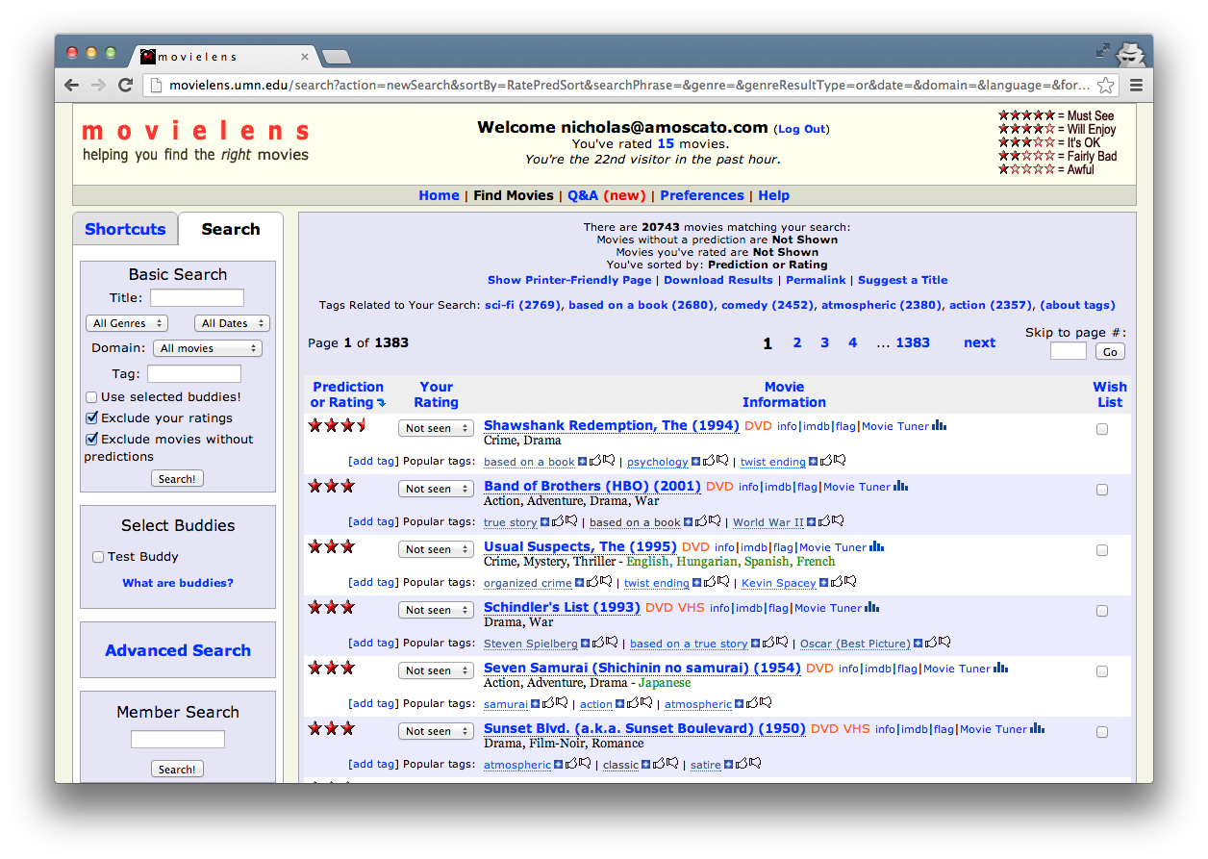

Slide 10
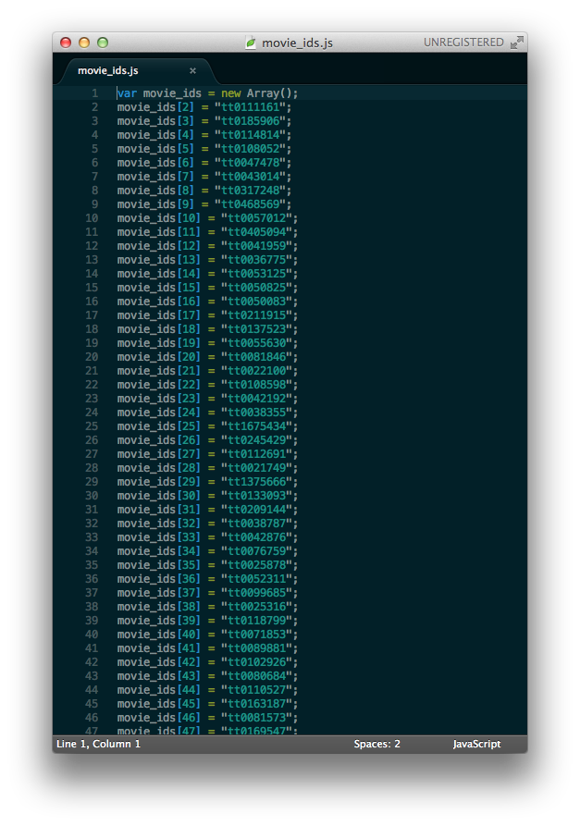
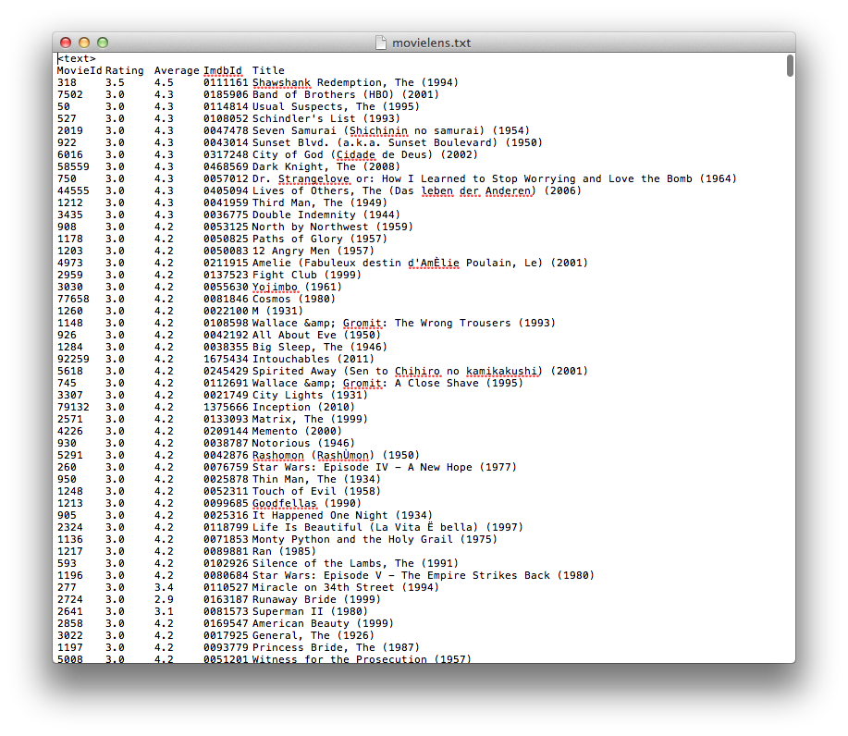

Slide 11


Slide 12


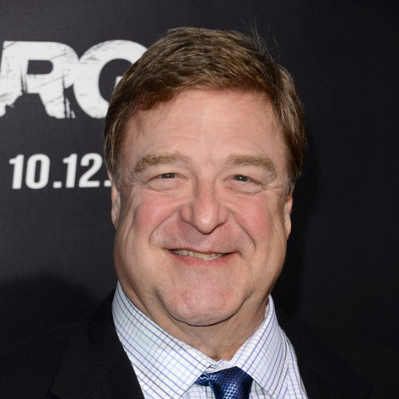
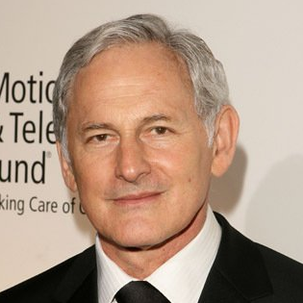
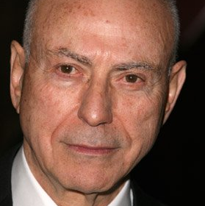
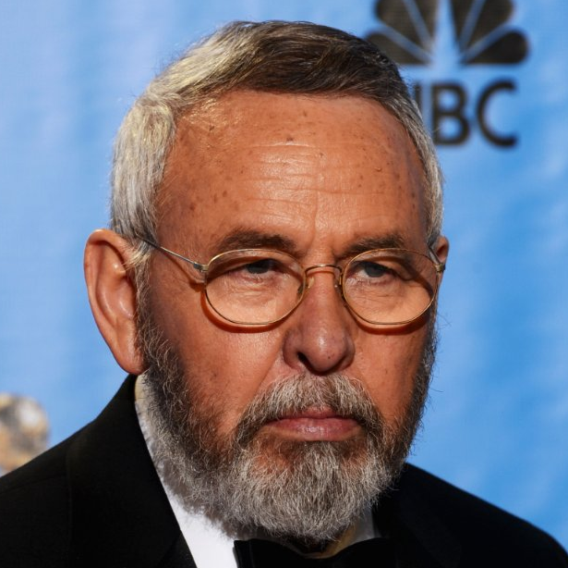

Cast Directors Writers Genres Language Country MPAA Rating Release Year Weekend Runtime
Drama, history, Thriller
English, Persian
USA
R
2012
YES
120 min

Slide 13
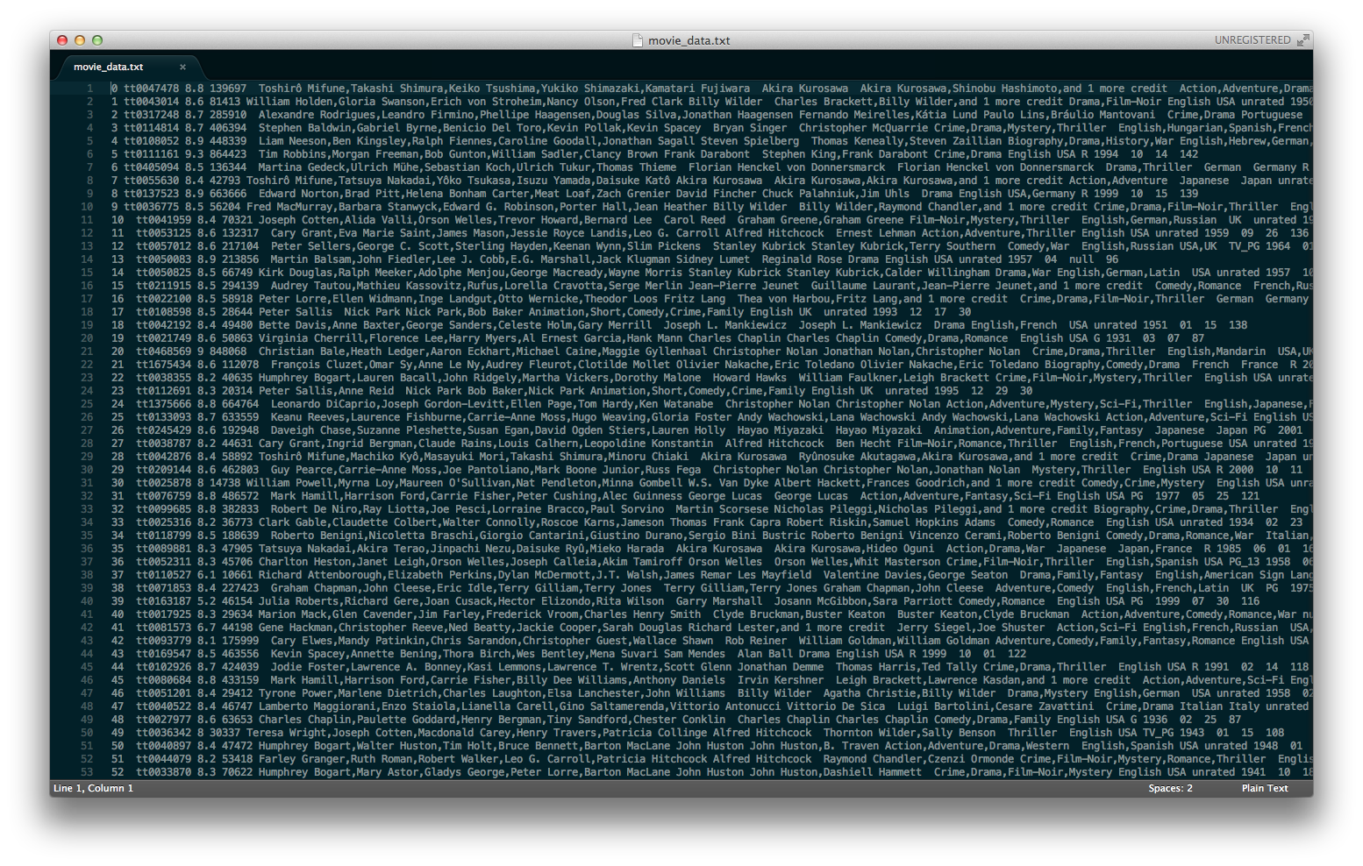


Slide 16
CLEAN DATA
REPLACED-MISSING DATA
11,889 Examples
17,240 Examples

Slide 17
Experiment SETUP
MODEL TREE & NEURAL NETWORK

Slide 18
Model Tree
adapted decision tree with
leaf node linear models

Slide 19
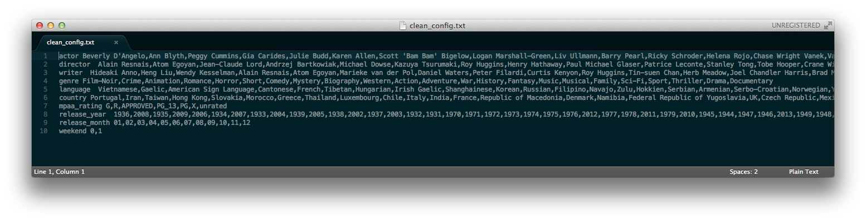
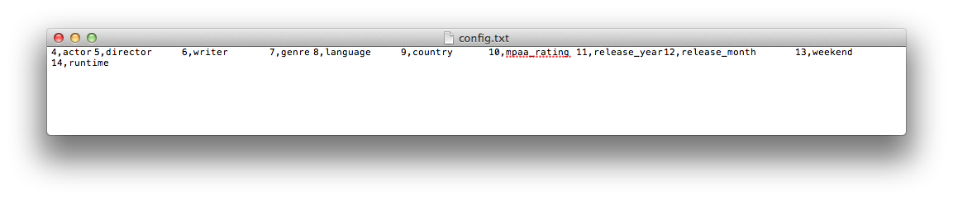
MODEL TREE CONFIGURATION

Slide 20
isWeekend
yes
no
MPAA
MPAA
G
…
R
…
Country
Genres
Director
Genres
Drama
Thriller
Horror
X
…
Y
…
Z

Slide 21
HIGH Cardinality
Lots and lots of actors

Slide 22
Actor 2
5 Actors
Actor 3
Actor 1

Slide 23
Neural Network
A Numeric Approach

Slide 24
Actor, writer, director score
Cumulative actor score
Individual Actor score
IMDB rating
Unable to split all the nominal features into an N set of binary values
Score is weighted by the participant’s rank in the film (e.g. lead actor gets high weight)

Slide 25

Weka implementation
Momentum
Hidden layers, number of neurons
Learning rate

Slide 26
Results and Interpretation
1,000 Examples – two models – Two Datasets

Slide 28
baseline
Predict average Rating
 | CLEAN | REPLACED-MISSING
AVERAGE RATING | 6.387 | 6.424
RMS | 1.045 | 1.081

Slide 29
Model Tree
Decision Tree With Linear Models
 | CLEAN | REPLACED-MISSING
SUBSET SIZE | 10 | 20
DEVIATION | 0.5 | 0.2
RMS | 0.931 | 0.992

Slide 30
NEURAL NETWORK
A NUMERIC APPROACH
 | CLEAN | REPLACED-MISSING
RMS | 0.980 | 1.088

Slide 31
Interpretation of neural network
Neural network seemed to choke on the nominal features in our dataset
Dividing them into binary values wasn’t feasible due to the computational complexity it created
The solutions we devised were probably not ideal and explain the relative weakness of the Neural Network result

Slide 32
At the end of the day…

Slide 33
Future Work
Additions & Alternatives

Slide 34
If we continued this project…
Access IMDB directly: some papers were able to get at more features of the IMDB data than we were, and with larger subsets to boot. For example: isAdaptation, isSequel, type of color (e.g. Technicolor), budget, costume designer
Limit to Subset: one paper examined only feature-length films made in US. Could be more feasible to identify attributes that are successful contained to one area.
Model Tree: try different linear functions at the leaf nodes

Slide 35
The End
Any Questions?

